Slide 1

De-Stress Service Application
Arshad Muthalif
Kaustubh Wade
Simran Gulani
Mohammed Taaha

Slide 2

Depression, Stress
WHO estimates that one in four people in the world will be affected by mental or neurological disorders at some point in their lifetime. Around 4500 million people are currently suffering from such conditions, placing mental disorders among the leading causes of ill-health and disability worldwide.
Globally, the total number of people with depression was estimated to exceed 300 million in 2015, equivalent to 4.3% of the world population.
Depression is ranked as the single largest contributor to global disability(7.5% of all years lived with disability in 2015). At its worst, depression can lead to suicide. Over 8,00,000 people die due to suicide every year. Suicide is the second-largest cause of death in 15-19-year-olds.

Slide 3

India
89% of Indians are suffering from Stress.
Stress levels are high in India as compared to other developing countries like USA, UK, Germany, France, China, Brazil and Indonesia, according to the 2018 Cigna 360° Well-Being Survey.
The survey explored people's concerns and perceptions on health and their sense of well being across all five key areas like physical, household, social, financial and work. The survey covered 14,500 people in 23 markets around the world.

Slide 4

Our Aim
Our focus is to provide the De-stress service to the people who are suffering from Depression.
Our application helps people to think the right way and overcome such situations.
The user can talk anonymously so they are not afraid of revealing their identity.
The user can communicate with a Psychologist or a well-trained bot.
The bot will provide suitable suggestions to the user.

Slide 5








Structure
Database
LUIS NLP
Server
Backend
Frontend

Slide 6
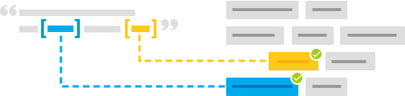

LUIS NLP
A machine learning-based service to build natural language into apps, bots, and IoT devices.
Designed to identify valuable information in conversations, LUIS interprets user goals (intents) and distills valuable information from sentences (entities), for a high quality, nuanced language model. LUIS integrates seamlessly with the Azure Bot Service, making it easy to create a sophisticated bot.

Slide 7
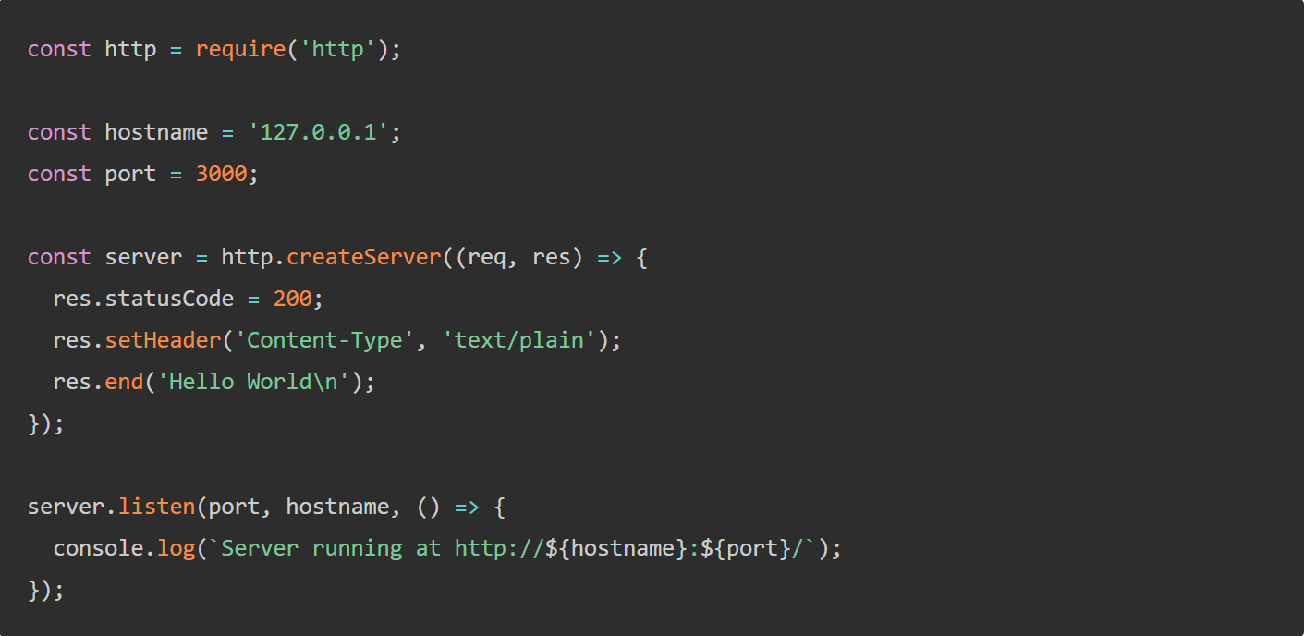
Nodejs
This is the Backend of our code.
LUIS will be included in Nodejs
Node.js will be the central point of our application.
The database will be stored in MongoDB which will be connected to Nodejs.
All the APIs will be created in Nodejs.

Slide 8

Reactjs
React makes it painless to create interactive UIs. Design simple views for each state in your application, and React will efficiently update and render just the right components when your data changes.
React Native is a JavaScript framework for writing real, natively rendering mobile applications for iOS and Android
Our project will have its own website and mobile application with the chat service included.
For Frontend, we will use Reactjs, while React-Native will be used to make a mobile application.

Slide 9
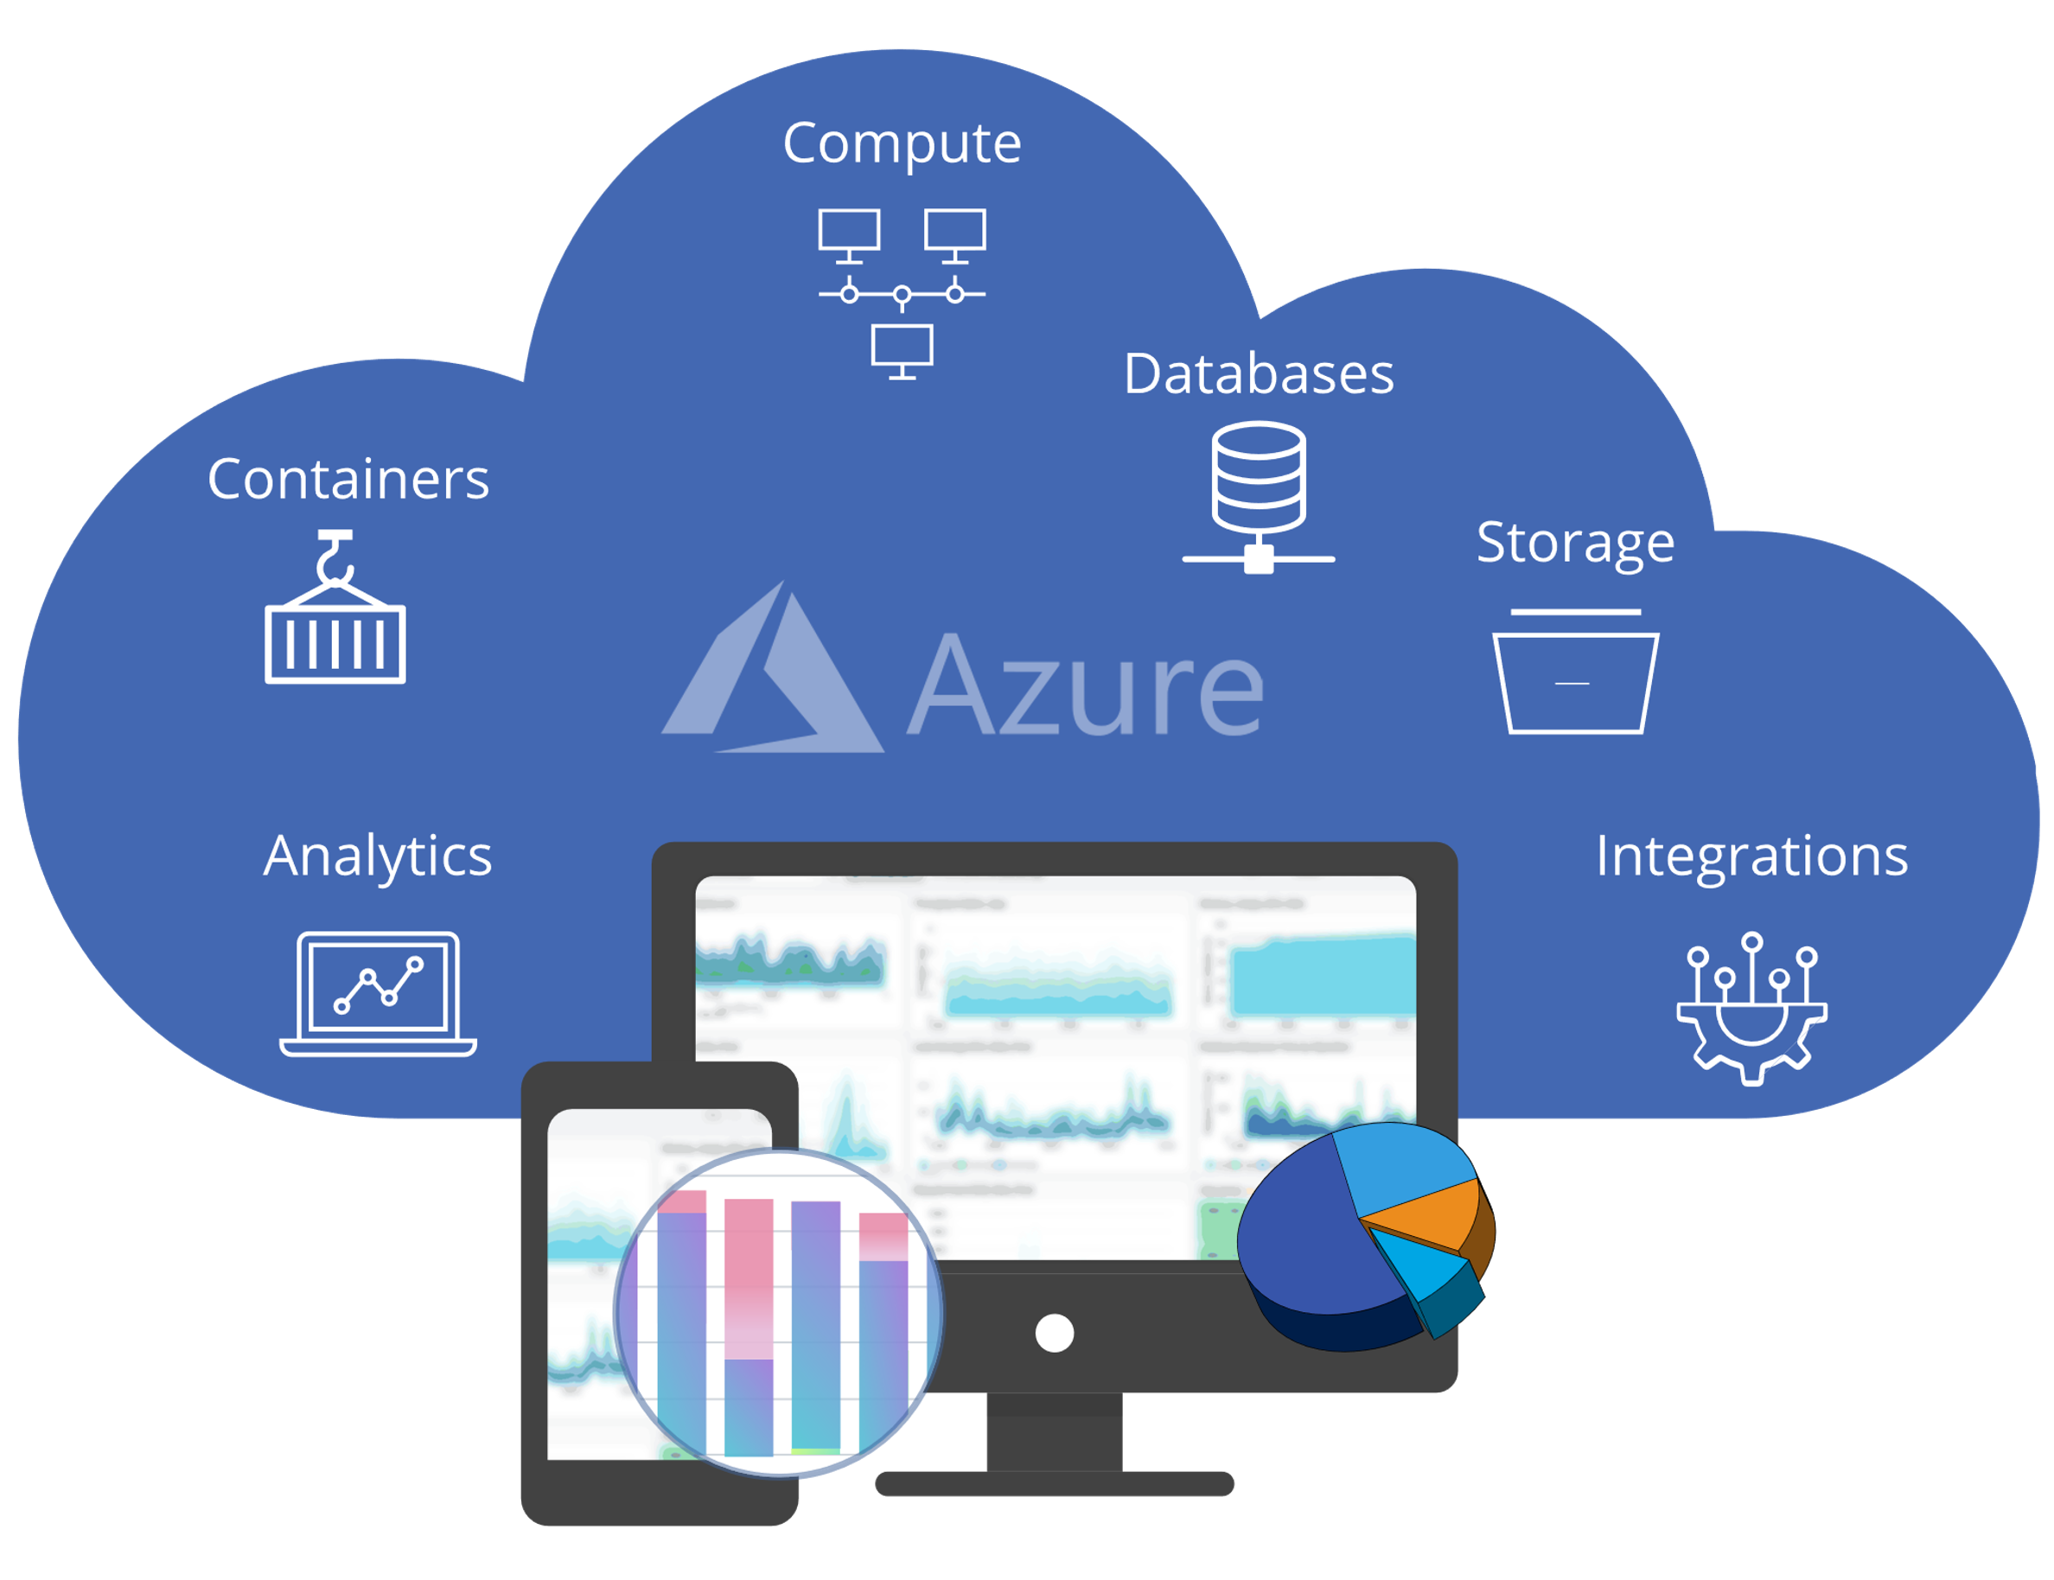
Microsoft Azure
Cloud computing is when you access computing services over the internet. For example, instead of storing personal documents and photos on your personal computer’s hard drive, most people now store them online.
Cloud computing platforms, like Azure, tend to be less expensive and more secure, reliable and flexible than on-premises servers.
We will use Microsoft Azure bot service to run our bot on Facebook and Skype. So the user can access our service from any platform.

